Slide 1
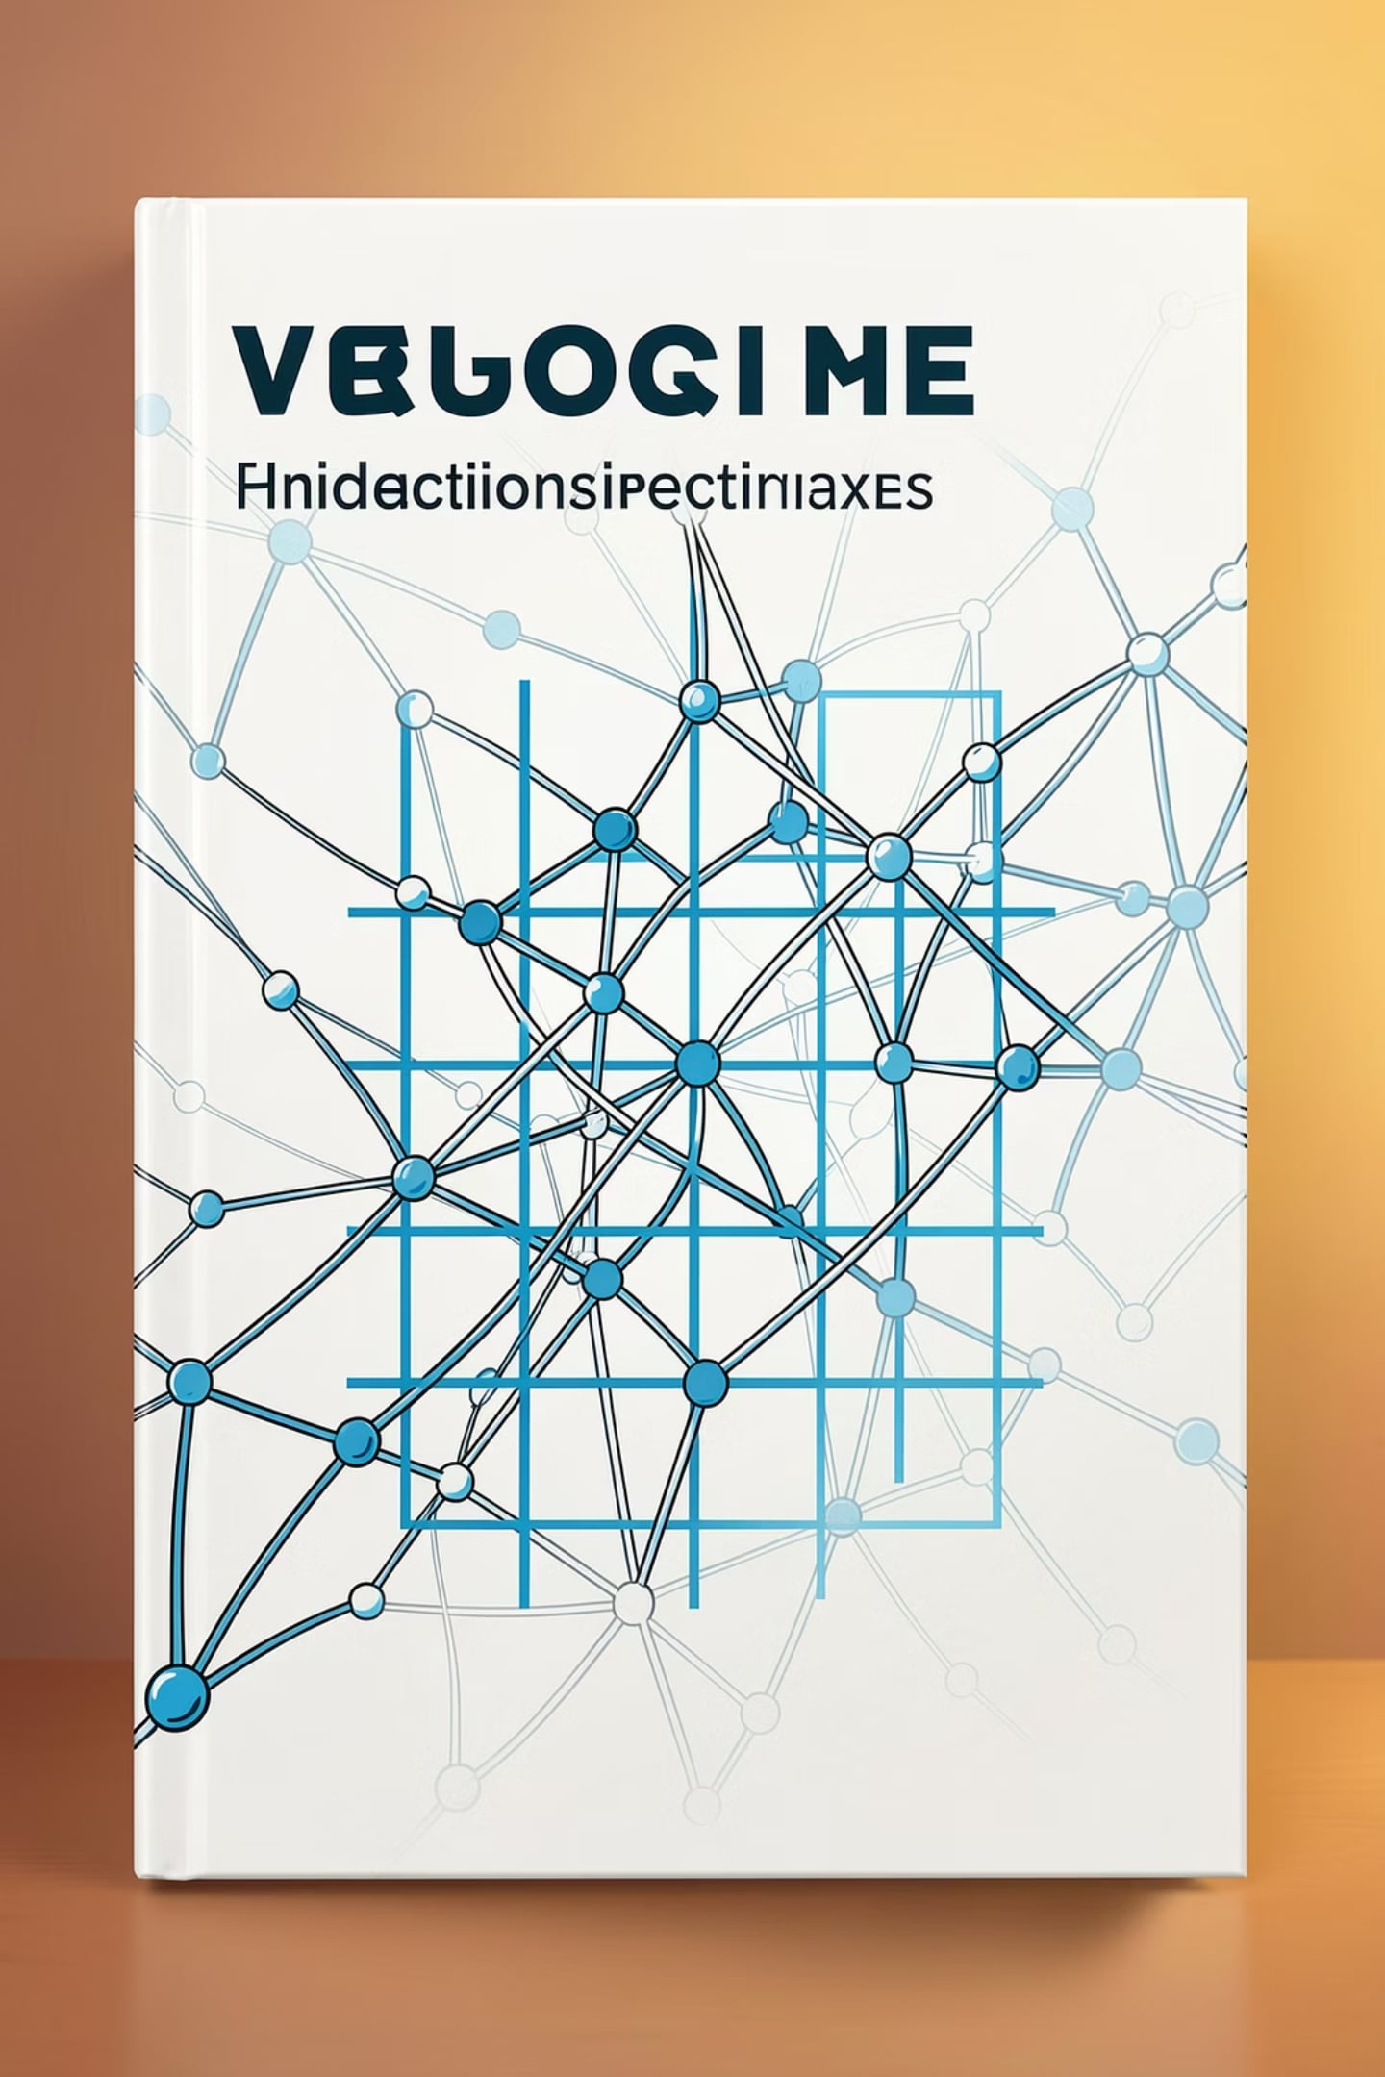
Tic-Tac-Toe AI: Minimax, Alpha-Beta Pruning & Heuristics
CSE 440 — Artificial Intelligence | Section 02 | Group 01
North South University | Summer 2026

Slide 2
Group Members
Name
Student ID
Sourav Roy
2121856042
Sudipta Karmakar
2132245042
Khatune Jannat
2131916642
Tabassum Tasnim Mridula
2211451042
Contact: github.com/souravnewbee/cse440-tictactoe-ai-group01

Slide 3
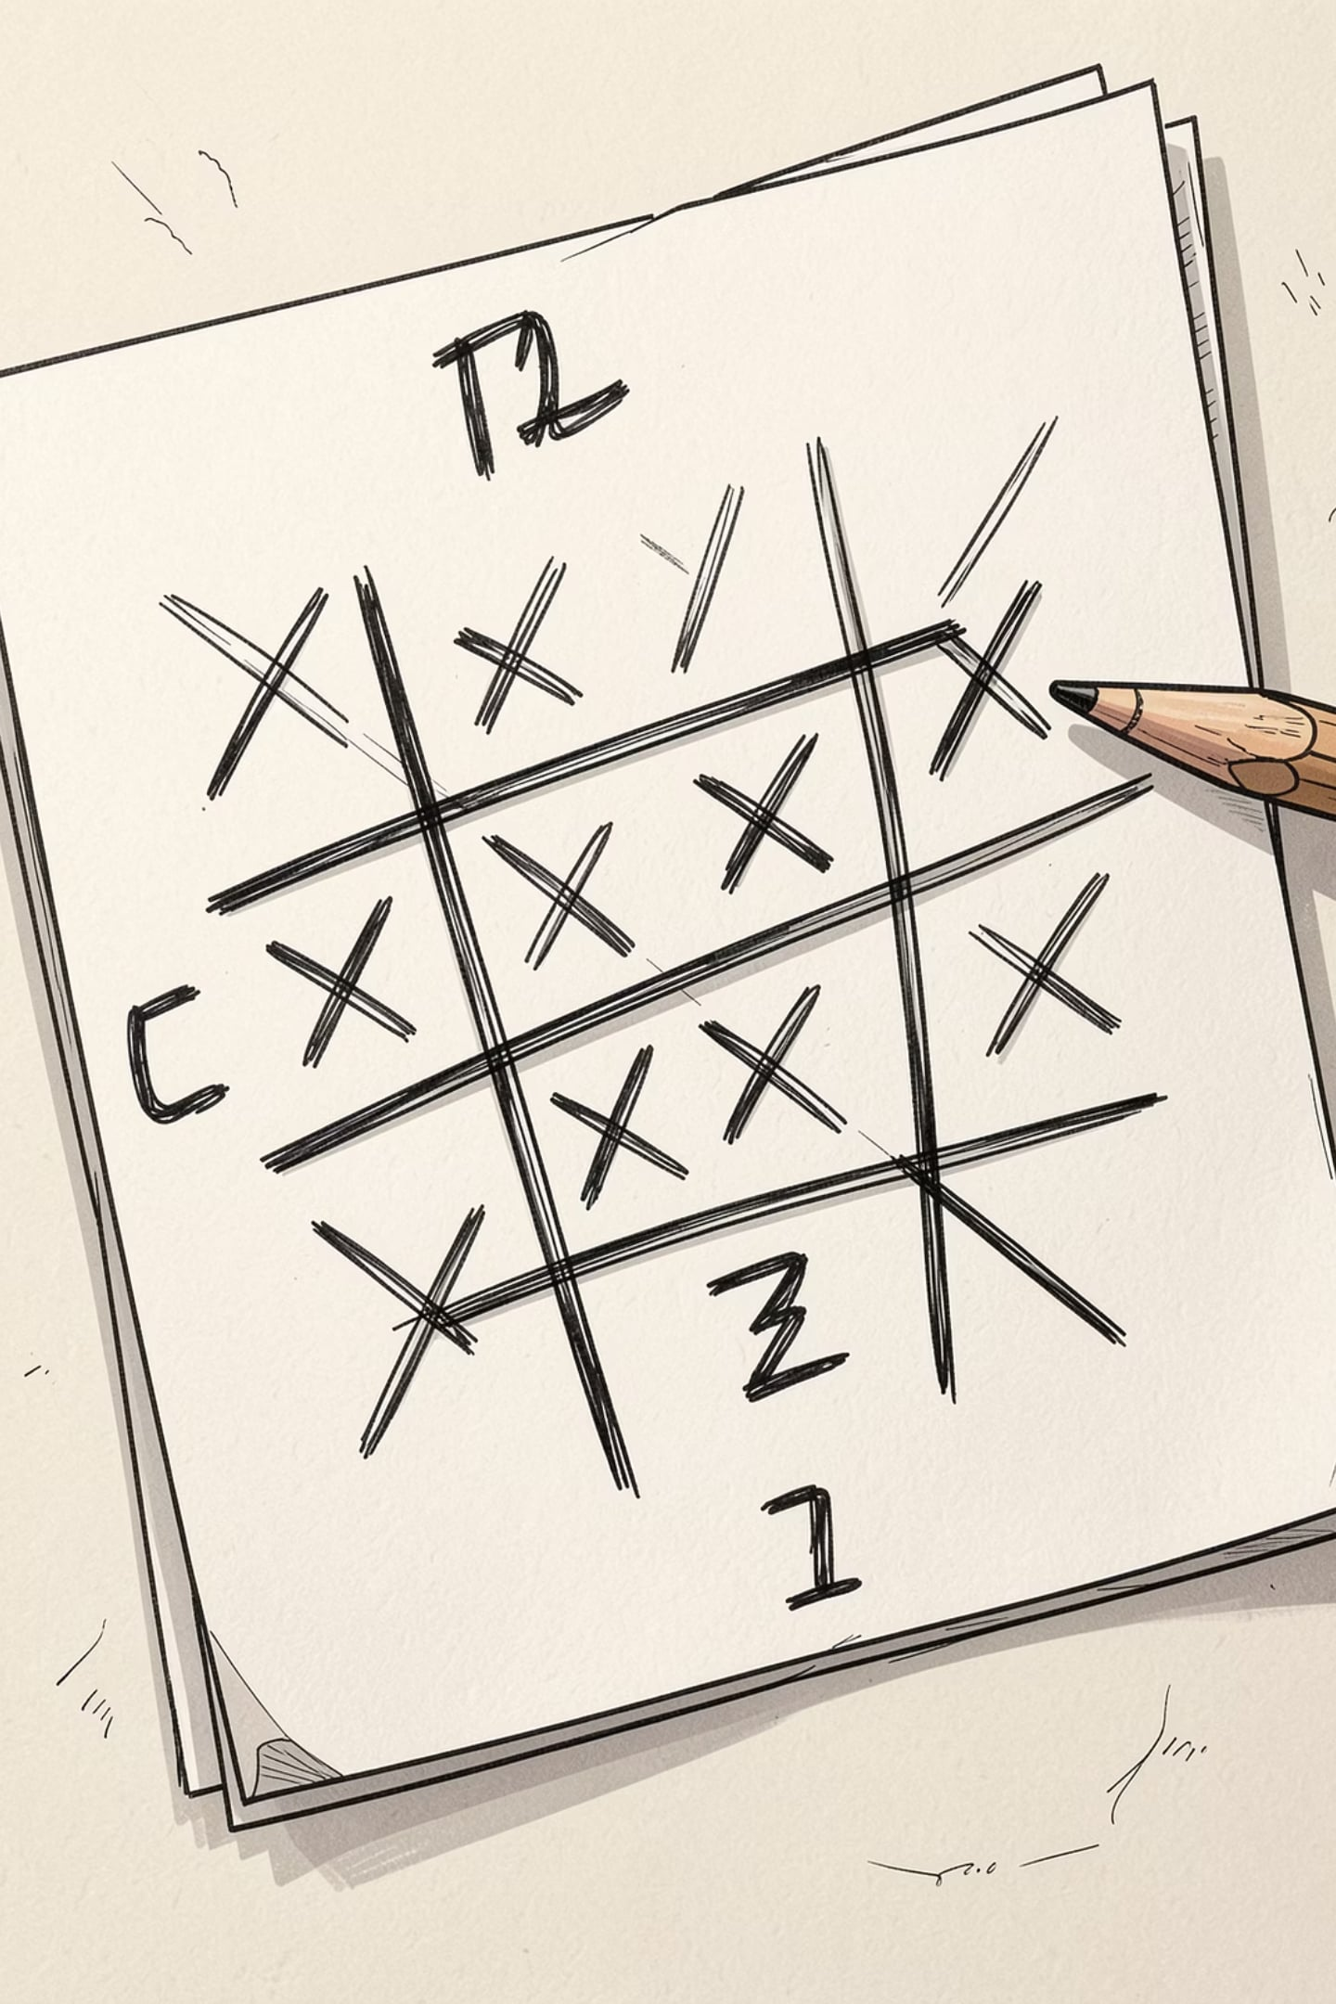
Project Overview & Objectives
Build an AI agent that plays Tic-Tac-Toe optimally against a human player.
Implement Minimax for exhaustive game-tree search and correctness.
Optimize decision-making with Alpha-Beta pruning to reduce explored nodes.
Design heuristic evaluation functions for faster play and imperfect-information testing.
Deliver a playable Human vs AI interface suitable for live demo.

Slide 4

Project Workflow
game.py (board & rules)
game.py (
minimax.py/ alpha_beta (AI decision logic)
main.py(integration, human vs AI)
GUI(coming in Week 8)
Each module was developed and tested independently, then integrated for full-stack functionality.
Notes:
• Walk through the workflow left to right: game.py → minimax.py → main.py → GUI • game.py - Handles the core game rules and board logic. This is the foundation that everything else builds on. • minimax.py - The AI algorithm that evaluates moves and determines the best strategy. This is where the intelligence comes in. • main.py - Integrates everything together. Connects the game logic with the AI decision-making. • GUI - The user-facing interface where players interact with the game. Built on top of all the backend modules. • Key point: Each module was developed and tested independently before being brought together. This modular approach made development cleaner and testing easier. • The result is a fully integrated system where all pieces work together seamlessly.

Slide 5
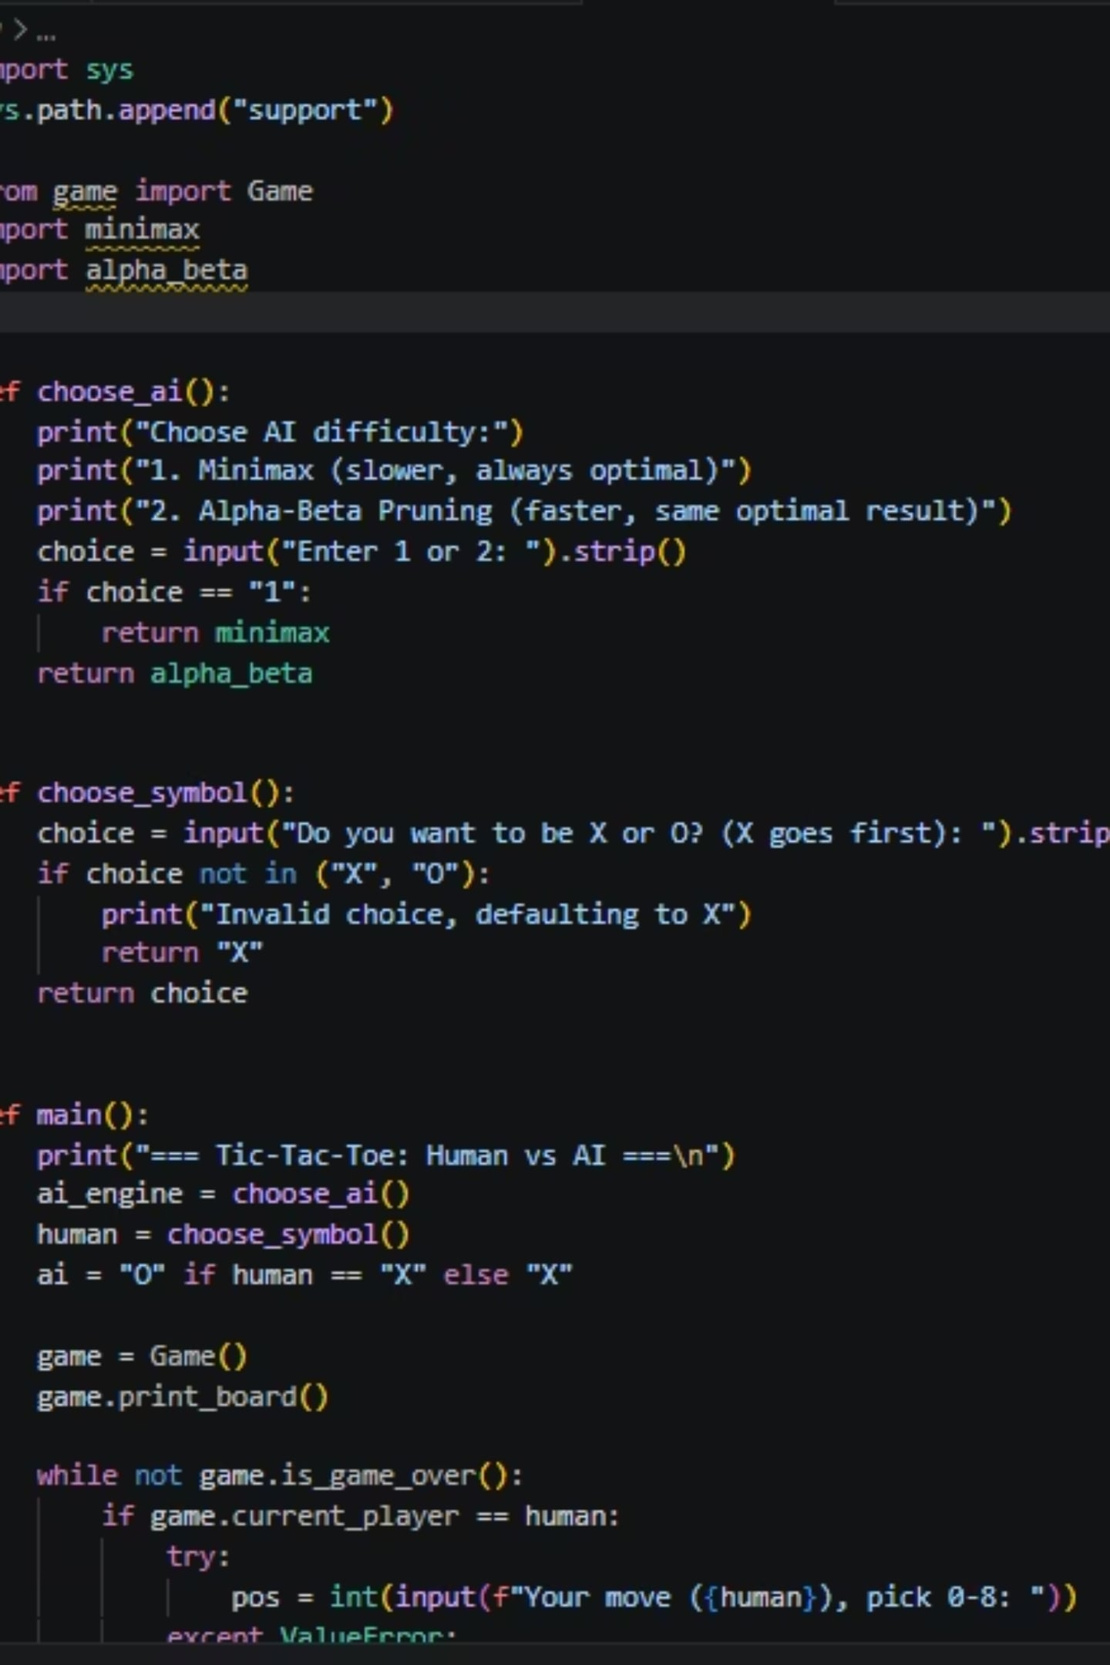
Progress: Weeks 1–3
Week 1 — Repo & Structure
Week 2 — Core Game
Sudipta: implemented board representation, CLI interface, win/draw detection and tests.
Sourav: repository setup, folder layout, README, contribution guidelines.
Week 3 — Minimax
Khatune: implemented Minimax algorithm, validated optimal play on full game tree.

Slide 6
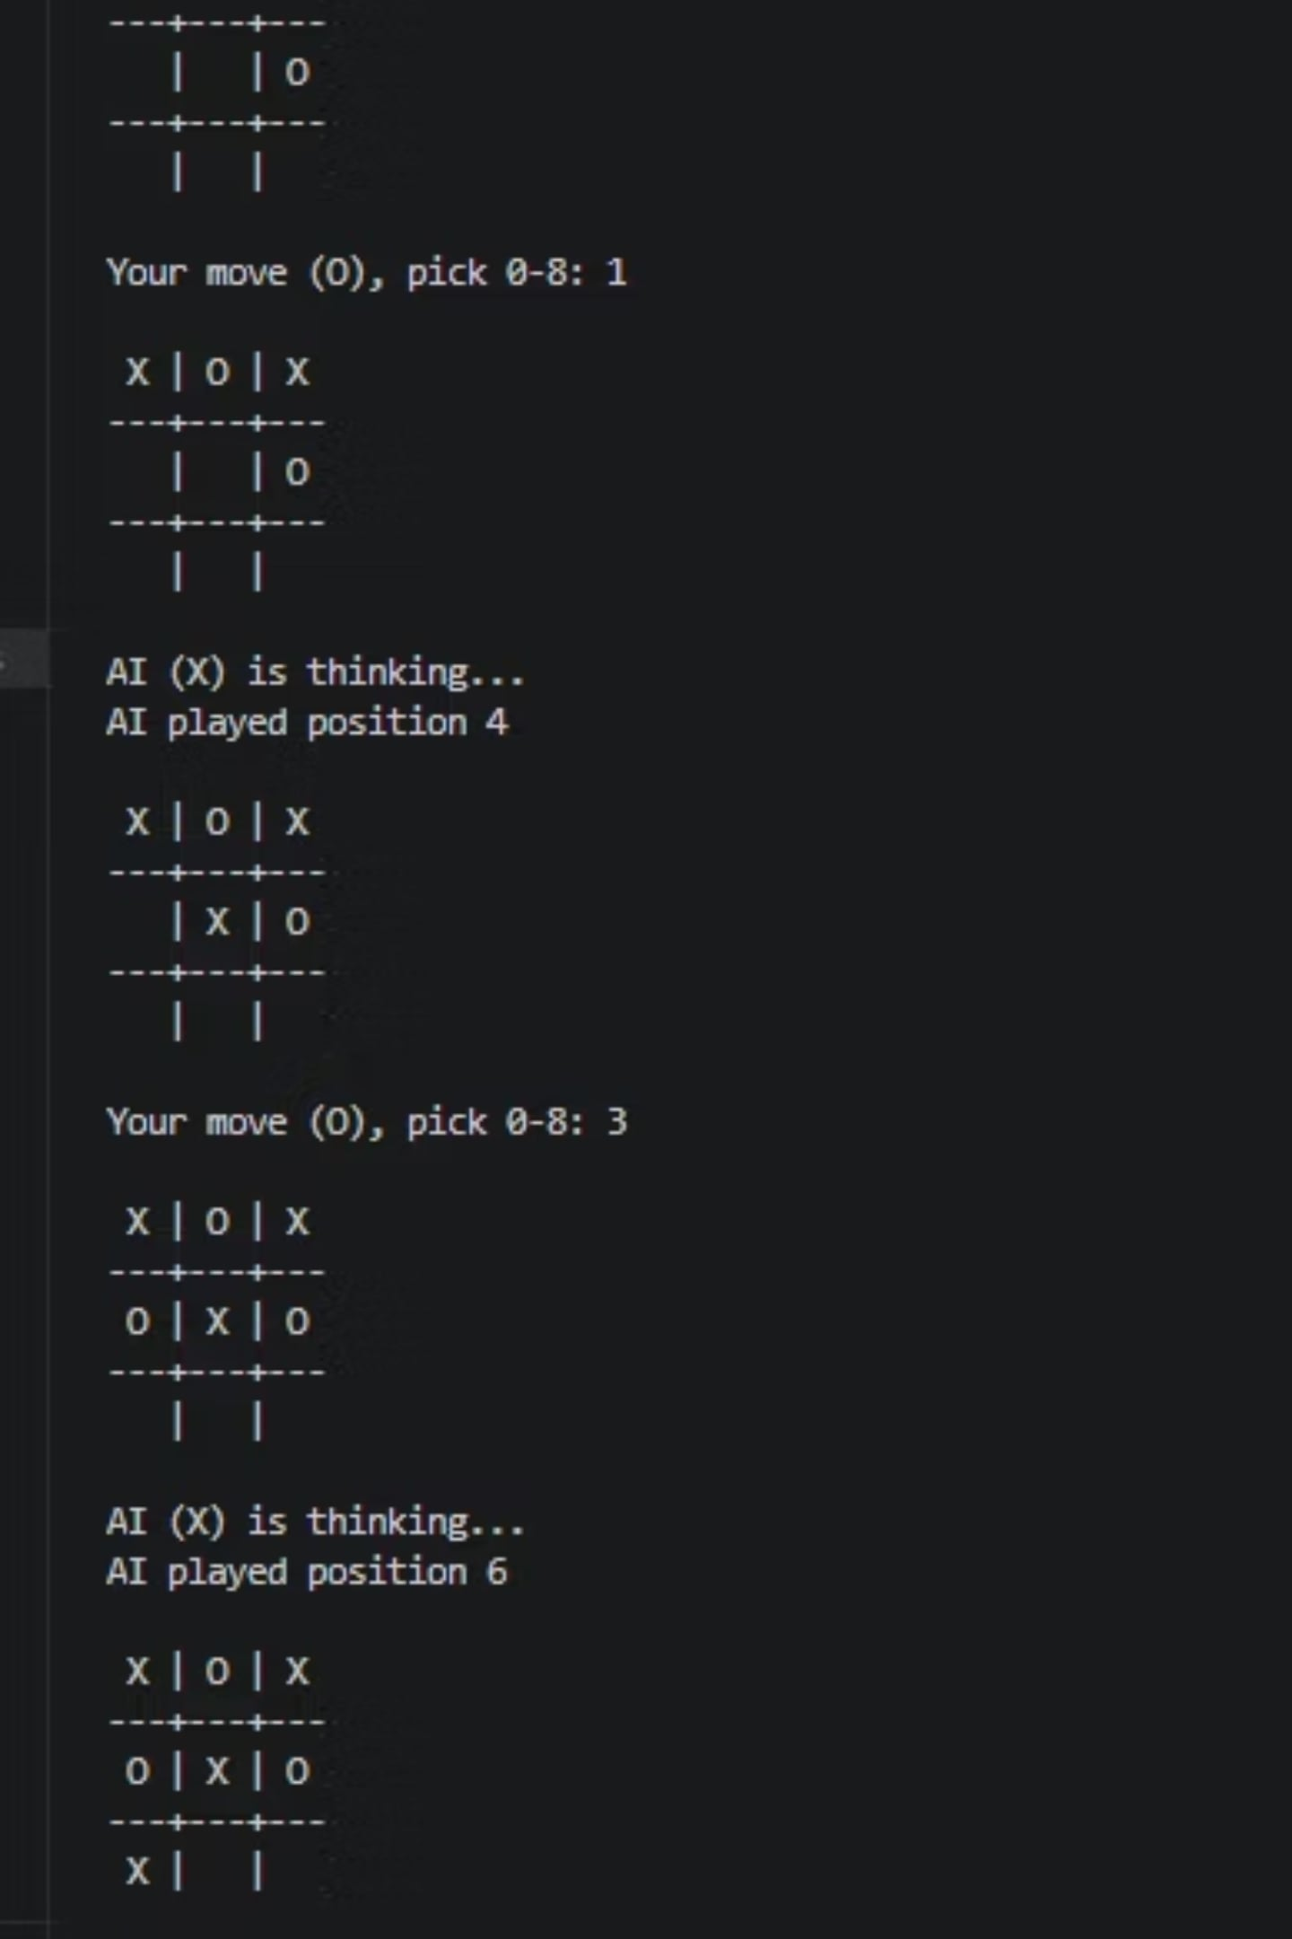
Progress: Weeks 4–5 & Current Status
Week 4 — Alpha-Beta Pruning optimization (Tabassum): reduced node expansions while preserving optimal moves.
Week 5 — Full integration & playability (Sourav): main.py ties CLI, AI modules, and tests; playable Human vs AI.
Status: Fully working — tested on GitHub Codespaces and ready for live demo.

Slide 7


Roadmap — What's Next
Week 6
Develop and test heuristic evaluation functions for faster approximate play.
Week 7
Performance analysis: benchmark Minimax vs Alpha-Beta vs heuristic-guided search.
Week 8
GUI implementation (Pygame or Tkinter) for user-friendly Human vs AI interaction.
Week 9
Finalize report, prepare final presentation and demo video.
Notes:
• Week 6 — We're moving into optimization territory. We'll be creating heuristic evaluation functions that let the AI make faster decisions without exploring every possible move. This is crucial for making the game actually playable. • Week 7 — Time to see what actually works. We'll run comprehensive benchmarks comparing our three search approaches — standard Minimax, Alpha-Beta pruning, and our new heuristic-guided search. This data will show us which strategy gives us the best balance of speed and decision quality. • Week 8 — Making it real. We're building the actual interface so people can play against the AI. Whether we go with Pygame or Tkinter, the goal is something intuitive and responsive. • Week 9 — The home stretch. We'll wrap up the final report, prepare our presentation, and create a demo video showcasing the AI in action.

Slide 8
Thank You — Questions?
Repository: github.com/souravnewbee/cse440-tictactoe-ai-group01
Prepared by Group 01 — CSE 440

